Slide 1

Apparel Recommendation System
Anindita, Siddharth, Rahul
( TEAM OPTIMIZERS )

Slide 2
Problem statement
Recommend similar apparel products based on text and Image features.
This is content-based recommendation, means its based-on title, text, Description text, images using amazon data set.
We are not doing collaborative based recommendation as Amazon doesn’t provide users data.

Slide 3
Motivation
To leverage text based and image-based recommendation.

Slide 4
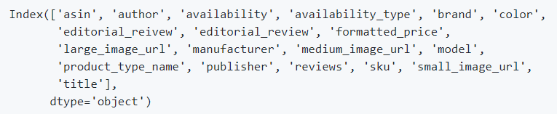
Data set
We use Amazon's Product Advertising API and get the required data. We took women's tops as the dataset . It consists of 1,83,000 datapoints, having 19 features each.

Slide 5
pipeline
TEXT BASED
Bag of words
TF-IDF
IDF
Average Word2Vec
IDF weighted Word2Vec
183k rows with 7 features
Removing duplicates
Text Preprocessing
A/B TESTING
IMAGE BASED
vgg 16 algorithm

Slide 6
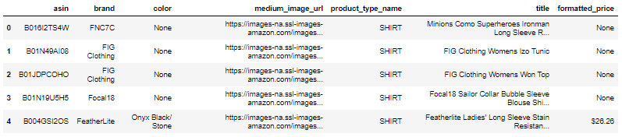
Dimensional reduction
asin (Amazon standard identification number)
brand ( brand to which the product belongs to )
color ( Color information of apparel)
product_type_name (type of the apperal)
medium_image_url ( url of the image)
title (title of the product)
formatted_price (price of the product)

Slide 7
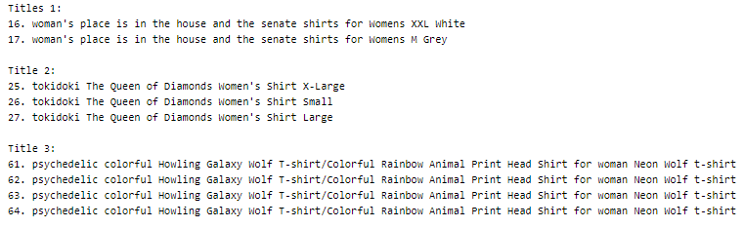
Data Preprocessing
We did statistical analysis for different features and ensured all the products have a title.
We removed 2325 duplicate products with same title but different color.
Removing duplicate sizes of the same product(Ex: same shirt of S, M, L)
Removing duplicate titles that differs only in the last few words

Slide 8
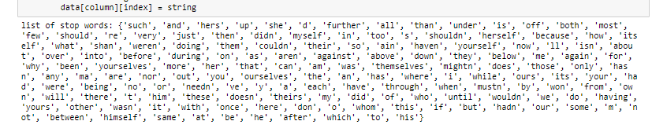
Text Preprocessing
We used list of stop words that is downloaded from nltk lib.
PorterStemmer() is used for stemming to convert bigger suffixes to smaller and simpler suffixes.

Slide 9
Text Based Product Recommendation
Text based techniques
Bag of words
TF-IDF
IDF
Text Semantics based techniques
Average Word2Vec
IDF weighted Word2Vec

Slide 10
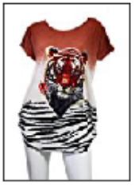
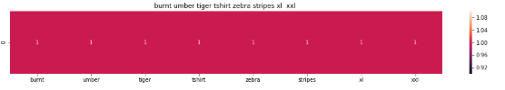

Test Model

Slide 11
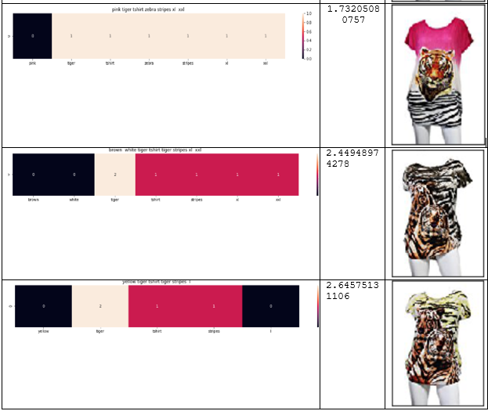
Bag of words on product titles

Slide 12
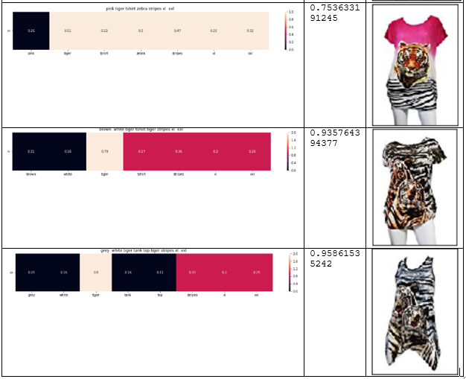
TF-IDF BASED PRODUCT SIMILARITY

Slide 13

IDF based product similarity

Slide 14
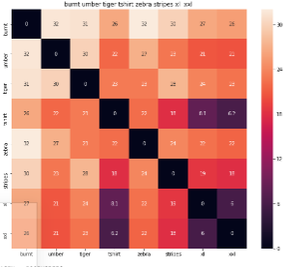

TF-IDF BASED PRODUCT SIMILARITY

Slide 15
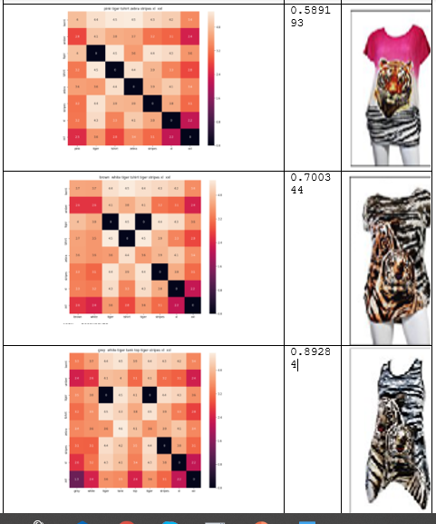
AVERAGE WORD2VEC PRODUCT SIMILARITY

Slide 16
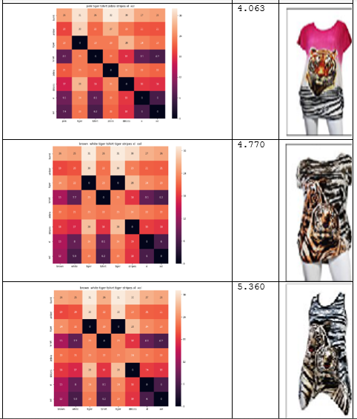
IDF weighted eord2vec for product similarity

Slide 17
Improvement areas
Weighted similarity using brand and color
Visual features-based product similarity
Image based Recommendation

Slide 18
A/B testing
we build two models, we split the users into 2 categories named A and B. we deploy both models on both categories and compare the results and decide the better model.

